Slide 1
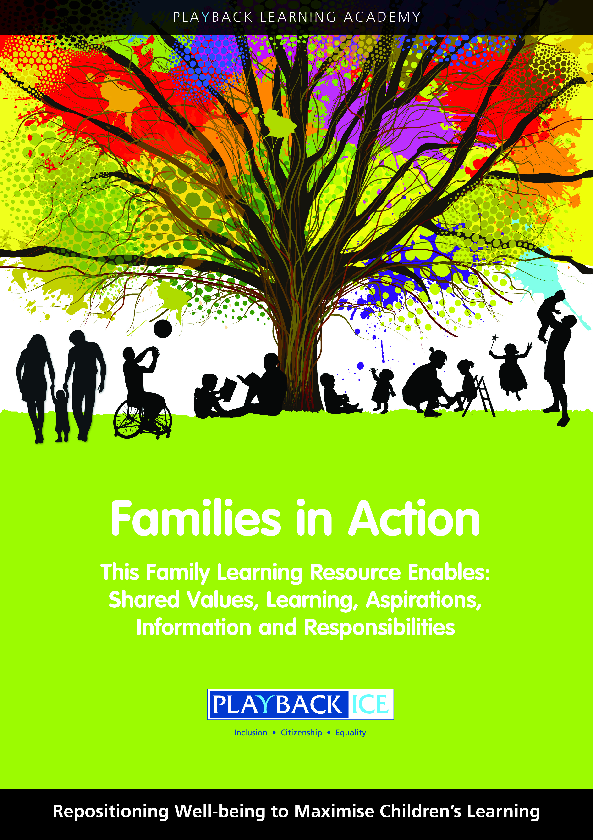
Families in Action
A Family wellbeing and
Learning Resource
Enabling families to become more engaged in their children’s wellbeing and learning.

Slide 2
What do we mean by Getting it right for every child (GIRFEC)?
Session 3:
Playback Learning Academy

Slide 3
Session 3: What do we mean by Getting it right for every child (GIRFEC)?
Aims to: Increase families’ awareness and understanding of the GIRFEC wellbeing indicators Explore what these mean to children within the school environment Identify what families can do to support their child in preparation for school and at home

Slide 4
Scottish Government GIRFEC Policy
The Scottish Government is committed to providing a consistent, supportive approach for all Scotland’s children and their families.
GIRFEC is the national approach to improving the wellbeing of children and young people.
GIRFEC wellbeing indicators are: Safe, Healthy, Active, Respected, Responsible, Achieving, Nurtured and Included.

Slide 5
GIRFEC
Means ‘Getting it right for every child’ and is being used with families, nurseries, schools, health care, social work, law enforcement, housing and some support services for adults.
It is designed to thread through all services and areas which involve children and young people of any age.

Slide 6
GIRFEC is a national approach:
Puts the best interests of the child at the heart of decision making
Takes a holistic approach to the wellbeing of a child
Works with children, young people and their families on ways to improve wellbeing

Slide 7
The GIRFEC approach:
Advocates preventative work and early intervention to support children, young people and their families
Believes professionals must work together in the best interests of the child

Slide 8
Getting it right for every child
The Children and Young People’s Act 2014 places GIRFEC on a statutory footing.
This legislation is based on planning for every child and a child’s plan for those who require more concerted processes of support across agencies like education, health and social care.
It supports children and their parents/carers to work in partnership with the services that can help them.

Slide 9
Our children’s wellbeing
Taking care of our children’s wellbeing and making sure they are alright – even before they are born – helps us ensure the most positive outcomes for them later in life.
It gives them the potential to grow up ready to succeed and play their part in society.
The benefits of taking good care of them are significant – both for the individual and for our society.

Slide 10
GIRFEC wellbeing Indicators Handout
Safe Healthy
Active Respected
Responsible Achieving
Nurtured Included

Slide 11
Discussion on the key facts about the 8 wellbeing indicators:
Every child or young person should be safe, healthy, achieving, nurtured, active, respected, responsible and included.
These eight wellbeing indicators help make sure everyone - children, parents, and the people who work with them, such as teachers and health visitors - has a common understanding of wellbeing.

Slide 12
Key facts:
The wellbeing indicators connect and overlap.
e.g. a health difficulty may have an effect on a child or young person achieving their goals or being active.
When considered together the different elements of wellbeing give the whole picture of a child's or young person's life at a particular point in time.

Slide 13
Key facts:
A child's or young person's wellbeing is influenced by everything around them.
This includes their individual circumstances, the support they get from their family and community, and the services that support them.
Factors such as adequate sleep, play and a healthy, balanced diet have a positive impact on all aspects of a child's or young person's wellbeing.

Slide 14
Key facts:
The effects of poverty and isolation can have a negative effect on their wellbeing.
It is up to all of us – e.g. parents, early learning providers, health visitors, teachers, GPs, police - to work together to promote, support and safeguard the wellbeing of all of our children and young people.

Slide 15
Key facts:
Children and young people have different experiences and needs at different times in their lives.
Understanding how this affects their wellbeing and providing the right support when they need it, helps them grow and develop and reach their full potential.

Slide 16
In summary:
Safe Protected from abuse, neglect or harm at home, at school and in the community.
Healthy Having the highest attainable standards of physical and mental health, access to suitable healthcare, and support in learning to make healthy, safe choices.
Achieving Being supported and guided in learning and in the development of skills, confidence and self-esteem, at home, in school and in the community.

Slide 17
In summary:
Nurtured Having a nurturing place to live in a family setting, with additional help if needed, or where not possible, in a suitable care setting.
Active Having opportunities to take part in activities such as play, recreation and sport, which contribute to healthy growth and development, at home, in school and in the community.
Respected Having the opportunity, along with parents and carers, to be heard and involved in decisions that affect them.

Slide 18
In summary:
Responsible Having opportunities and encouragement to play active and responsible roles at home, in school and in the community, and where necessary, having appropriate guidance and supervision, and being involved in decisions that affect them.
Included Having help to overcome social, educational, physical and economic inequalities, and being accepted as part of the community in which they live and learn.

Slide 19
Playback Learning Academy - GIRFEC statements for children
Consider the GIRFEC statements for children
Provide potential responses that children could provide.
Clarify any points made about what they can do to improve the experiences for their children at home and in school

Slide 20
Discuss:
How can parents/carers support the school to deliver this government policy, sharing responsibility and ensuring children are well prepared for learning when they arrive at school?
How can they help to achieve a healthy learning environment for children?
How will they know if they are successful?

Slide 21
Family activity at home:
Explain the purpose of the activity and why it is important for children to:
Better understand the wellbeing indicators
Understand what they mean and how they relate to them

Slide 22
Feedback/closing summary

