Slide 1
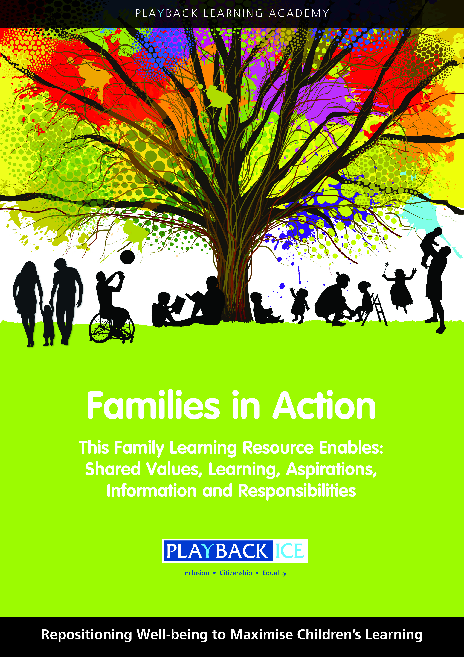
Families in Action
A Family wellbeing and
Learning Resource
Enabling families to become more engaged in their children’s wellbeing and learning.

Slide 2
Session 20:
How do children plan and set targets?
Playback Learning Academy

Slide 3
Session 20: How do children plan and set targets?
Aims to: Explore the importance of planning and setting targets Identify in what ways we can support children to plan and set targets for their learning and personal improvement

Slide 4
Introduction
What is action planning and what are the steps required for it to be successful?
How did you feel when you have achieved a goal e.g. a new job, organising a football game or planning a birthday party/event?

Slide 5
Why is it important for children to think about and understand
the importance of planning and setting targets for their learning
And personal development?
The four steps to target setting:
1. Goals - what they want to achieve
2. Steps to success - what they need to do to get there
3. Timescales
4. Evaluate - how will they know

Slide 6
The Five P’s Theory:
1. Planning
2. Preparation
3. Prevents
4. Poor
5. Performance
Applying these can support children to be successful in their planning and build their confidence.
Henry Mintzberg's 5 Ps of Strategy

Slide 7
Activity
Action Plan

Slide 8
Family activity at home:
Explain the purpose of the activity including why it is important for children to:
Understand want we mean by action planning, setting targets and planning for improvement

Slide 9
Family activity at home:
Before you introduce the activity introduce and discuss The Five P’s Theory with them:
Planning, preparation, prevents poor performance
Applying these steps can help them to be successful in their planning and confidence building.

Slide 10
Family activity at home: ask your child to identify a target/goal.
What do I want to achieve?
What must I do to achieve my goal?
How long will it take me to get there?
Who can help me?
How will I know if I have achieved my goal/target?

Slide 11
Action Plans
Support your children to complete their
Action Plans
by designing their own
graphically illustrated timeline or mind map

Slide 12
Feedback/closing summary

