Slide 1
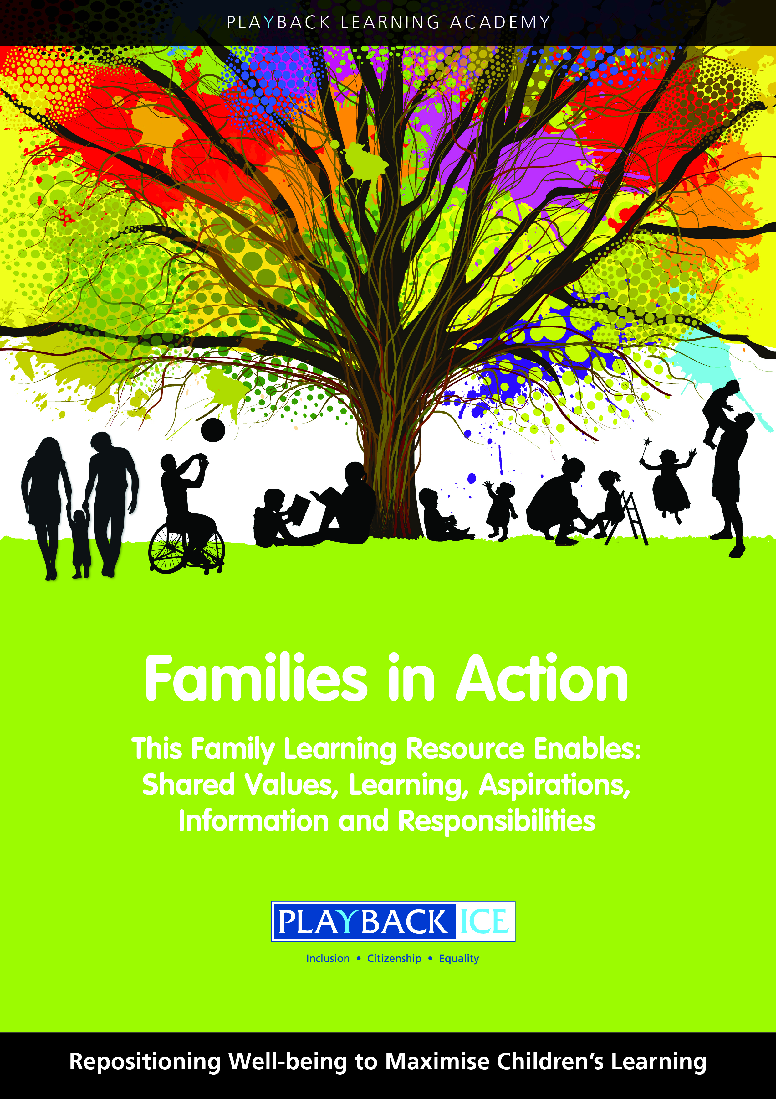
Families in Action
A Family wellbeing and
Learning Resource
Enabling families to become more engaged in their children’s wellbeing and learning.

Slide 2
Session 15:
How can children develop self-help skills?
Playback Learning Academy

Slide 3
Session 15: How can children develop self-help skills?
Aims to: Explore the correlation between being independent and being an effective learner Identify how we can encourage children to be independent in school Explore ways to support children develop self-help skills at home Reinforce the importance of supporting children to be independent

Slide 4
Introduction
There is a significant correlation between being independent and being an effective learner.
Encouraging children to do things for themselves has a positive impact on them.
Encouraging children to do things for themselves develops their self-esteem, become more independent and confident to learn.

Slide 5
Promote choices and independence
When we offer and promote choices and independence this will help children to feel responsible, confident and trusted.
With increased independence children will be more confident to express themselves.
Children will understand the impact of their choices and decisions and be more aware of their responsibilities.

Slide 6
Do you encourage dependence or independence at home?
What choices do you offer?
For example. household chores or self-care?

Slide 7
Distribute the Self-help Skills at School
Activity

Slide 8
Distribute the Self-help Skills at Home
Activity

Slide 9
Family activity at home:
Explain the purpose of the activity including why it is important for children to:
Identify their self-help skills and development needs at home

Slide 10
Discuss the following after the activity:
Was there anything that surprised you as parents/carers?
Could your children identify anything that they could not do?
Could your children identify what self-help skills they need to develop?
Do your children have skills they do not use at home?

Slide 11
Ideas for parents/carers to support children could include:
Using lists or timetables
Encouraging children in decision making
Encouraging children to take responsibility for specific jobs around the house
Being specific when asking them what you want them to do
For example. ‘Tidy your room’ can be too vague. Use post it or checklist.

Slide 12
Feedback/closing summary

