Slide 1
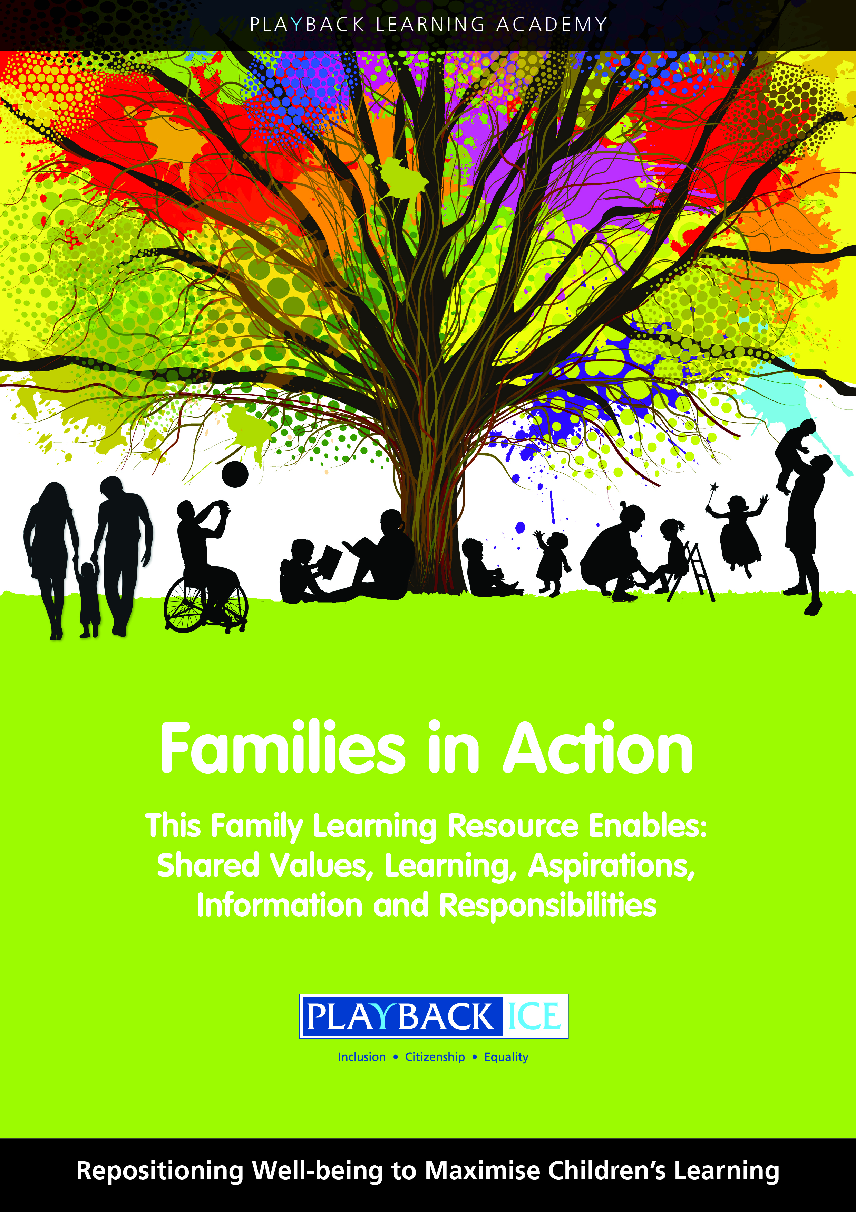
Families in Action
A Family wellbeing and
Learning Resource
Enabling families to become more engaged in their children’s wellbeing and learning.

Slide 2
Session 11:
How do we support children to develop positive emotions?
Playback Learning Academy

Slide 3
Session 11: How do we support children to develop positive emotions?
Aims to: Explore what we mean by emotions and how these can change in different situations Identify how our emotions impact on ourselves and others Identify ways that children can manage emotions positively and reduce negative emotions Identify why it is important children know who to talk to help them cope with negative emotions

Slide 4
Introduction
What do we mean by our emotional self?
How can we support children to understand their emotions and that their emotions can change in different situations?
Why is it sometimes difficult to say how we feel?
Should we always say what we think?

Slide 5
What do we mean by coping skills/resilience?
How we can support children to express their feelings and manage their emotions positively?
How children react to situations depending on their attitude/previous experiences?

Slide 6
How might your child react in this scenario…..
They have been selected for their sports’ team?
How would they express themselves?
Their friend was also looking forward to being selected for the sport team but has not been picked.
How could they support their friend to feel better and cope with their feelings of disappointment?

Slide 7
How might your child react in this scenario…..
Explore how they would feel if they have received a ticket to see their favourite boy/girl band. Their friend doesn’t receive a ticket.
How do they think their friend would be feeling?
How could they help their friend not to feel negative emotions, to feel better?
How could their friend cope with their feelings of disappointment?

Slide 8
Positive emotions statements
Consider the Positive emotions statements to help children to recognise how they could react emotionally to a range of situations
How should we encourage children to focus their energies on positive emotions?
Who can listen to them and help them to cope with negative emotions?

Slide 9
Family activity at home:
Explain the purpose of the activity and why it is important for children to:
Recognise how they react emotionally in different situations
Understand how their emotions impact on them and others
Focus their energies on positive emotions
Identify someone who listens to them and will help them to cope with negative emotions

Slide 10
Positive Emotions Statements
 | I must learn to like myself
 | I will try to stay calm
 | I will always talk to someone I can trust
 | I will avoid people who ask me to take risks
 | I will never put myself in a dangerous situation
 | If I am feeling bad, I will do something positive
 | I will avoid situations that make me feel negative
 | I will not let negative emotions take over and affect other areas of my life

Slide 11
Complete the Positive Emotions statements provided.
Remind your child that you can help them with these emotions and adopt more positive feelings
Ask your child to create a positive rap song in order to get their message/feelings across, or create ‘I’m positive’ poster using magazine images, ICT, photographs or write a poem entitled ‘I’m positive’

Slide 12
Feedback/closing summary

