Slide 1
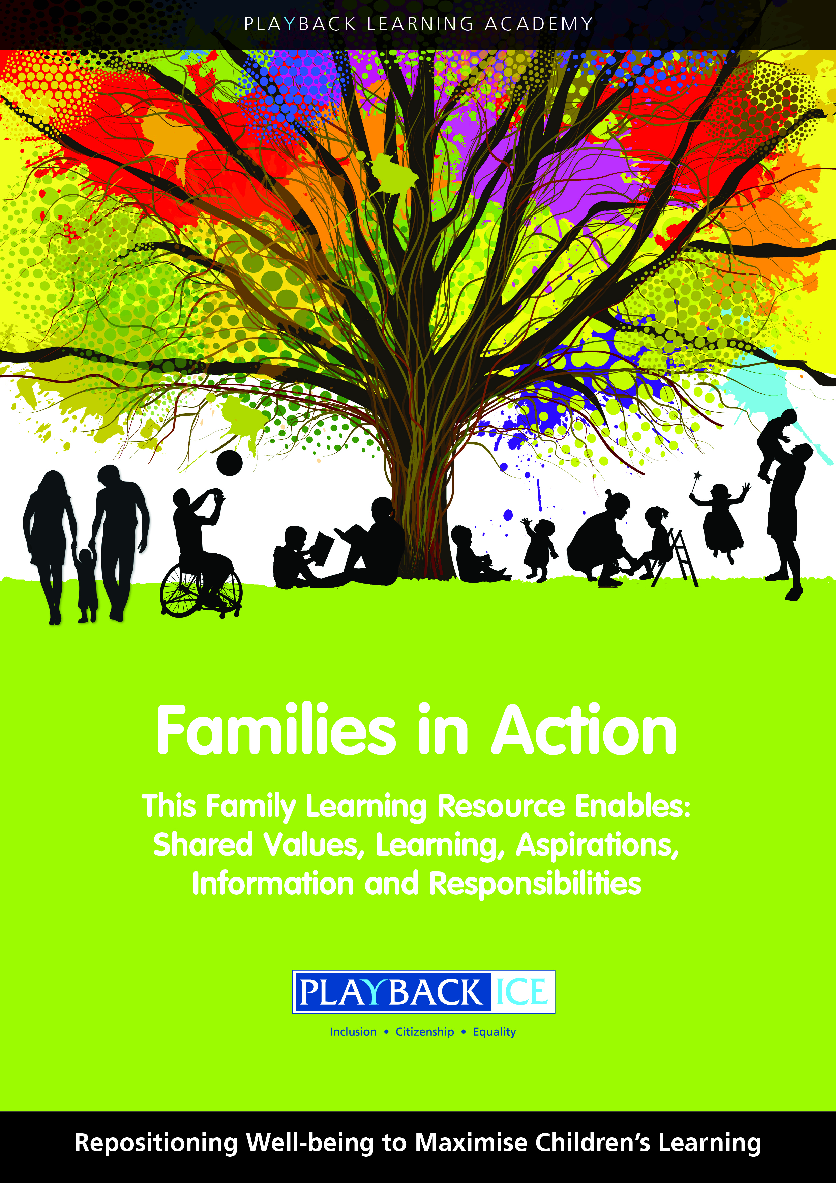
Families in Action
A Family wellbeing and
Learning Resource
Enabling families to become more engaged in their children’s wellbeing and learning.

Slide 2
Session 10:
How do children explore the similarities in people and what makes us different?
Playback Learning Academy

Slide 3
Session 10: How do children explore the similarities in people and what makes us different?
Aims to: Explore the similarities in people and what makes us different Recognise how our perceptions can influence our opinions of people who are different from us Recognise why it is important children identify the positive aspects of themselves and to accept people who are different from them

Slide 4
Introduction
Reflect the meanings of same and different :
Is everyone the same or different?
Should we all be the same?
Why is it good that we have differences?
Identify positive and negative aspects of being different
In what ways would you want to be the same? e.g. everyone wants to have friends – everyone wants to be included etc.

Slide 5
What do we have in common and what makes us unique ?
Consider the term ‘perception’ and how perceptions of situations and people can often be incorrect.

Slide 6
Discuss:
‘Looks can be deceiving’ – ‘Don’t judge a book by its cover’
Why it is important to:
Understand what we mean by perceptions and being different
Be aware of people’s perceptions affect their view of what is different

Slide 7
Do our perceptions affect the way we behave towards
other people?
For example: people with a disability, different cultures, beliefs, transgender etc.
Does it matter if people are different?
Should people be treated in a different way because they appear to be different?

Slide 8
Family activity at home:
Explain the purpose of the activity and why it is important for children to:
Recognise what is the same and what is different about themselves
For example: physical appearance, skills, qualities, things they like don’t like, talents, interests, values, beliefs and opinions

Slide 9
Family activity at home:
The positive and negative things of being different
Are there things that make us all the same e.g. everyone wants to have friends – everyone wants to be included etc?
In what ways would you want to be/not be different?

Slide 10
Family activity at home:
What do their children have in common with others as well as something unique about them?
Should people be treated in a different way because they appear to be different?

Slide 11
Feedback/closing summary

